Slide 1
Capstone Project Predicting the NFL Draft
DATASCI 420 AB
05/31/2018
Zach Gongaware

Slide 2
Project Goal
Every year around 16,000 college football players graduate or become eligible for the NFL draft.
Of these, only 253 (≅ 1.6%) are drafted each year, with around 100-200 additional signing as undrafted free agents
Can we use a model to predict which players will be drafted, and if so what round (1-7) they will be selected?

Slide 3
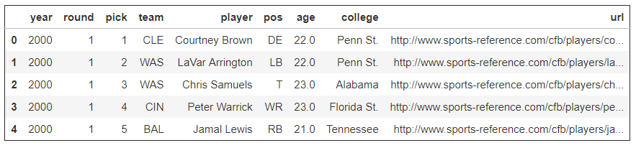
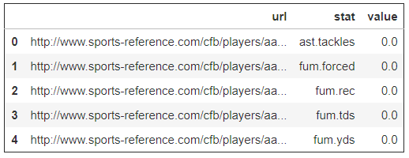
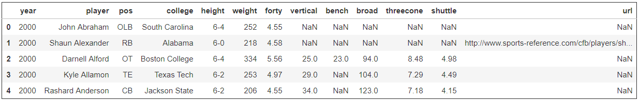
The Data
Draft Results
College Statistics
Combine Results

Slide 4
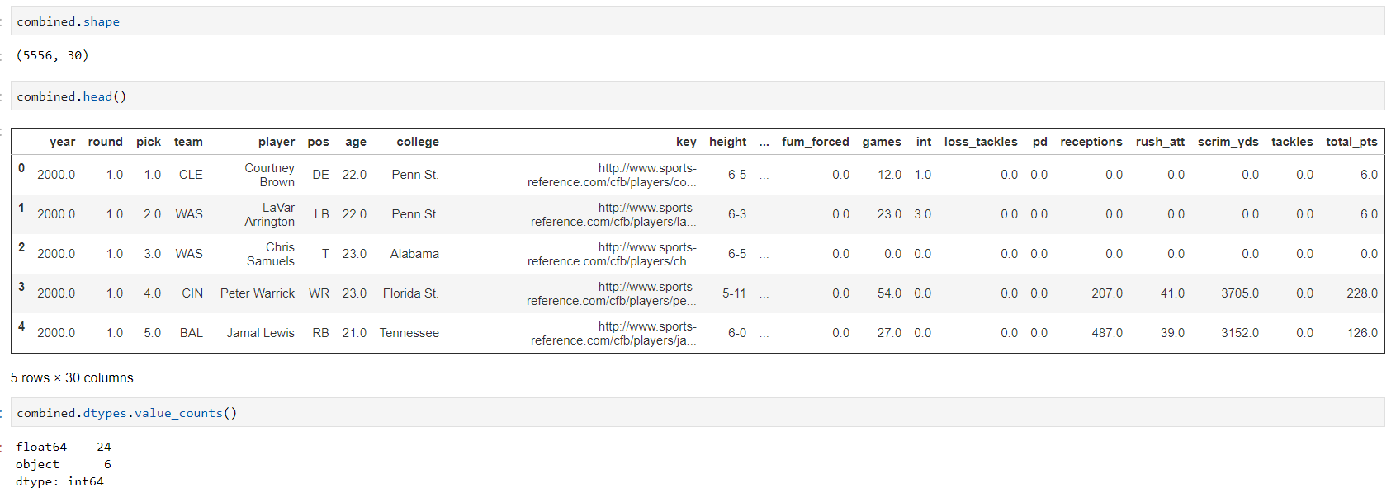
Combined Data - EDA

Slide 5
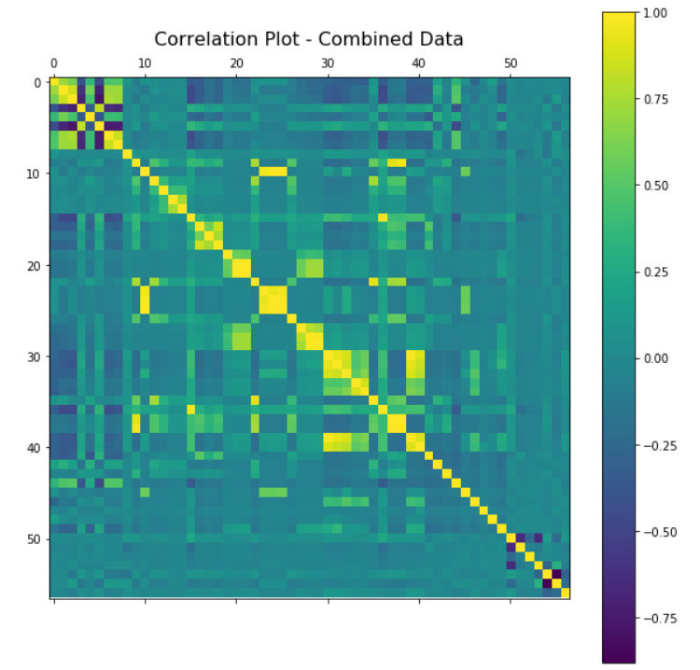
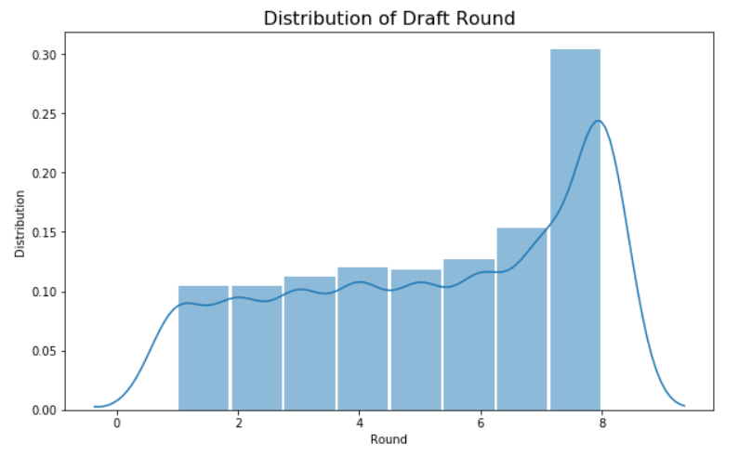
Combined Data - EDA

Slide 6
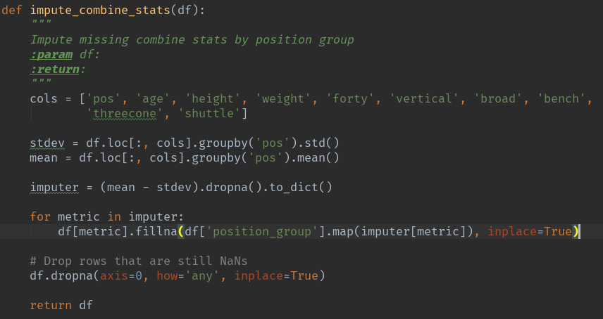
Feature Engineering
Height to Inches (6’2” -> 74)
Bin age based on draft expectations
Bin colleges based on historical draftees (tiers 1 – 4)
Impute Combine Stats
All players have measurables, but not all were measured
Imputed using mean – 1 standard deviation of player position for each combine test

Slide 7
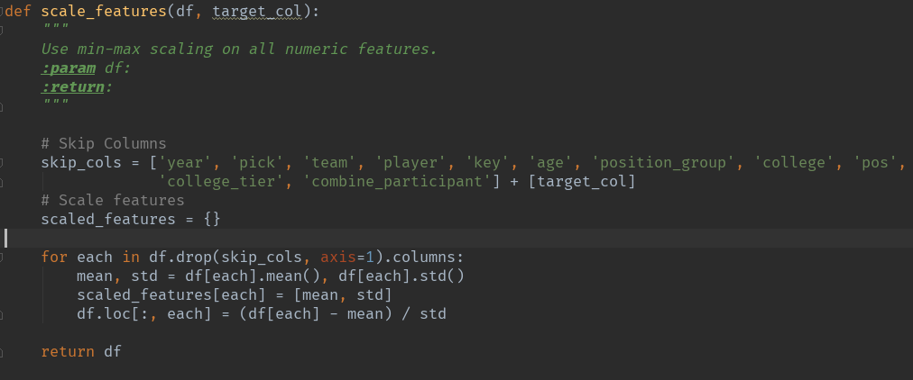
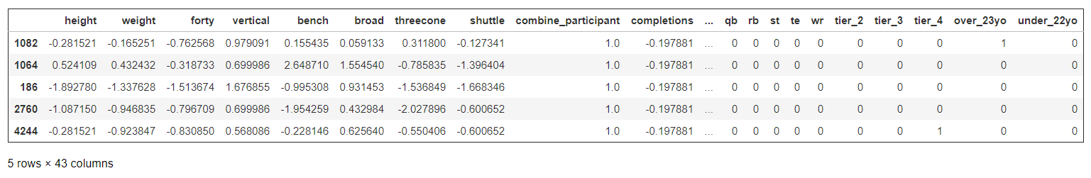
Modeling Preparation
Feature Scaling
Scale all non-categorical features using Z-Score
One-hot Encode Categorical Features
Position, College Tier, Age Bin
Split into Test/Train Sets

Slide 8
Modeling
Classification or Regression?
Discrete or continuous?
Does order matter?
High dimensionality and relatively low amount of measurements.
Decision:
Random Forest Regressor

Slide 9
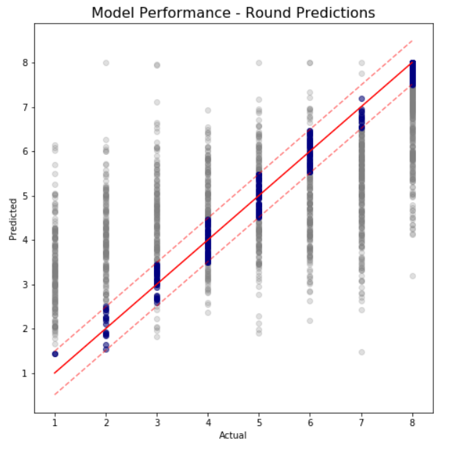
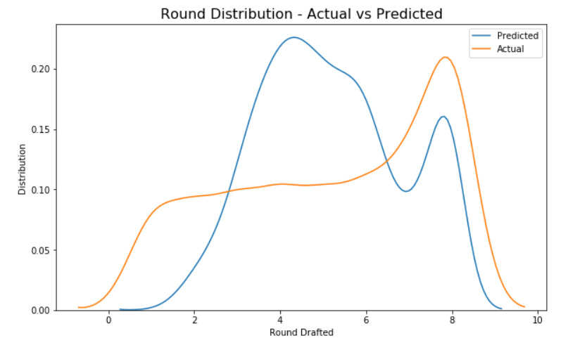
Model Assessment
R² - 0.525
Mean Squared Error: 2.76
Mean Absolute Error: 1.30

Slide 10
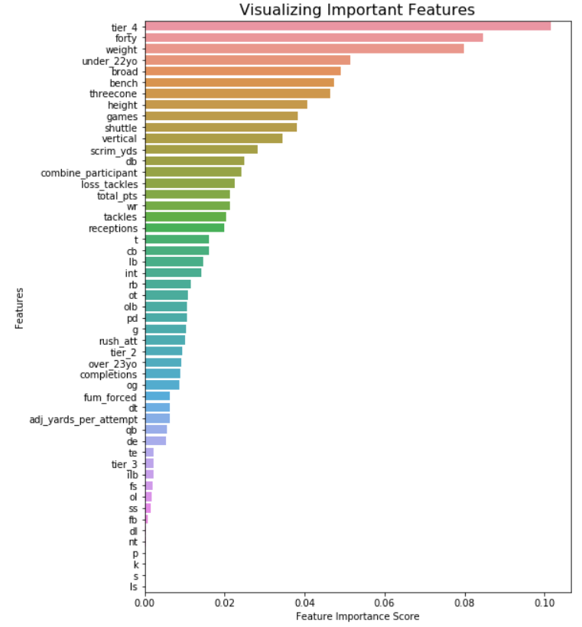
Model Measurement
Many of the imputed measurements fall near the top of feature importance.

Slide 11
Next Steps / Closing Thoughts
The model is better than flipping a coin, but there is plenty of room for improvement.
The model performs particularly poorly at early-round (1 – 2) predictions, and overly prefers the middle rounds (3 – 5).
Improvements
Better imputation methods for combine statistics. Mean-based imputation may be the reason for over-preference in middle rounds.
Find a better method for dealing with highly correlated features.
Advanced NFL statistics such as DVOA or QBR that combine multiple features into one.
Find more data – more (and more complete) college profiles

